Slide 1
Final Report - Recommendation system
Build a Personalized Online Course Recommender System with Machine Learning
Giriganuru Bhanukiran

Slide 2
For future reading, I am delighted to invite you for visiting my personal repository of IBM Machine Learning Professional Certiﬁcate @Coursera
Bhanukiran97/recommender_systems_model (github.com)

Slide 3
Outline:
Capstone Overview
Exploratory Data Analysis and Feature Engineering
Unsupervised Learning based Recomendation System
Supervised Learning based Recomendation System
Deploy and showcase models on Streamlit
Conclusion and future work
Appendix

Slide 4
Capstone Overview - Motivation
The main goal of this project is to improve learners' learning experience via helping them quickly ﬁnd new interested courses and better paving their learning paths. Meanwhile, with more learners interacting with more courses via your recommender systems, your company's revenue may also be increased.
This project is currently at the Proof of Concept (PoC) phase so the main focus at this moment is to explore and compare various machine learning models and ﬁnd one with the best performance in off-line evaluations.

Slide 5
Capstone Overview - Machine learning pipeline
Collecting and understanding data
Performing exploratory data analysis on online course enrollments datasets
Extracting Bag of Words (BoW) features from course textual content
Calculating course similarity using BoW features
Building content-based recommender systems using various unsupervised learning algorithms, such as: Distance/Similarity measurements, K-means, Principal Component Analysis (PCA), etc.
Building collaborative-ﬁltering recommender systems using various supervised learning algorithms
K Nearest Neighbors, Non-negative Matrix Factorization (NMF), Neural Networks, Linear Regression, Logistic Regression, RandomForest, etc.
Deploying and demonstrate modeling via a web app built with streamlit. Streamlit is an open-source app framework for Machine Learning and Data Science to quickly demonstration.
Reporting in paper.

Slide 6
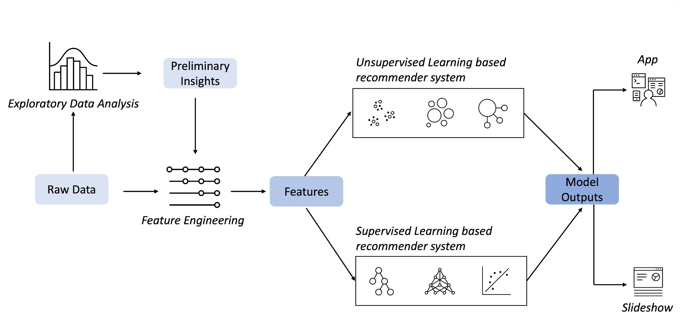
Capstone Overview - Machine learning pipeline

Slide 7
Exploratory Data Analysis and Feature Engineering

Slide 8
Exploratory Data Analysis
Pipeline:
Describe the statistic of data columns
Identify keywords in course titles using a WordCloud
Determine popular course genres
Calculate the summary statistics and create visualizations of the online course enrollment dataset

Slide 9
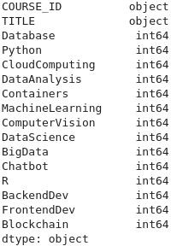
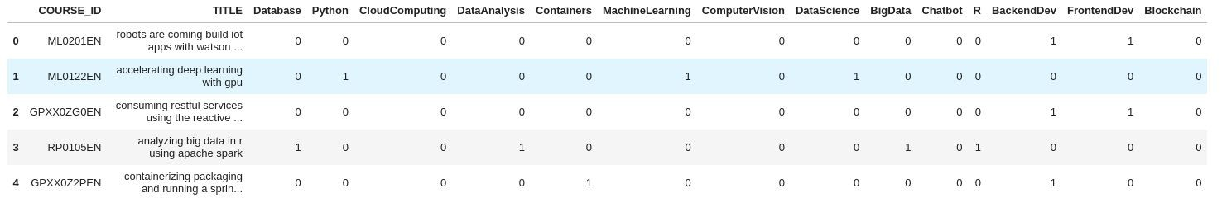
Exploratory Data Analysis
Describe the statistic of data columns
There are 307 courses at total.
Each course is a vector of genres 1x16.
means this course is not related to this genre.
means this course is related to this genre.

Slide 10
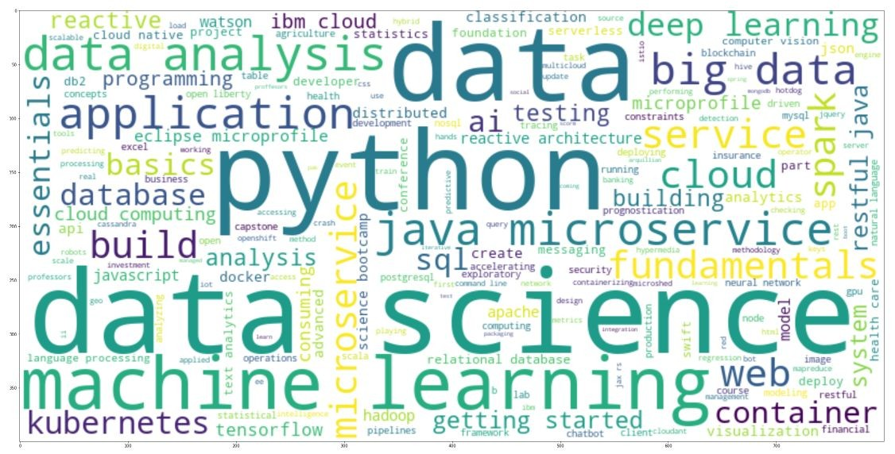
Exploratory Data Analysis
The omnipresences following by size respectively are:
data ->
data science ->
python ->
machine learning ->
data analysis ->
application ->
big data ->
java ->
microservice
web
Identify keywords in course titles using a WordCloud

Slide 11
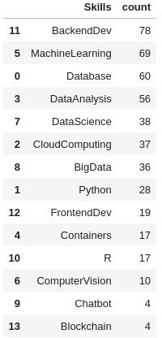
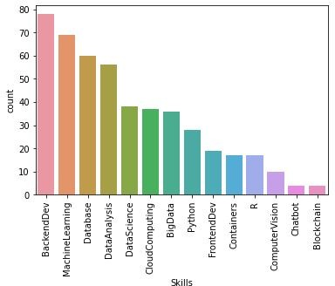
Exploratory Data Analysis
Determine popular course genres
BackendDev, MachineLearning, Database are the utmost popular genres. While Blockchain, Chatbot, ComputerVision are the most less common ones.

Slide 12
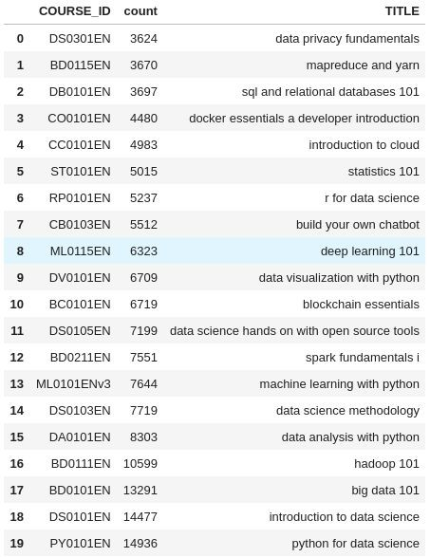
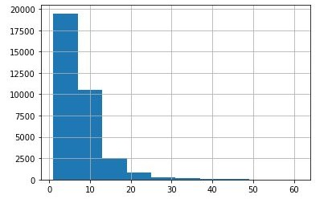
Exploratory Data Analysis
This below table shows top 20 widespread couses.
9/10 courses of top 10 are belong to data topic.
This given histogram illustrates the amount of user rating counts.
Only the 4th is the part of software engineer topic.
Almost users did not rate any courses or rated rarely.
Top 20 Most Popular Courses
A few exceptional students rated above 40 courses.
The histogram of user rating counts

Slide 13
Feature Engineering
Pipeline:
Extract Bag of Words (BoW) Features from Course Textual Content
Bag of Words (BoW) features
BoW dimensionality reduction
Extract BoW features for course textual content and build a dataset
Calculate Course Similarity using BoW Features
Calculate the consine similarity between two example courses
Find similar courses to the specific course

Slide 14
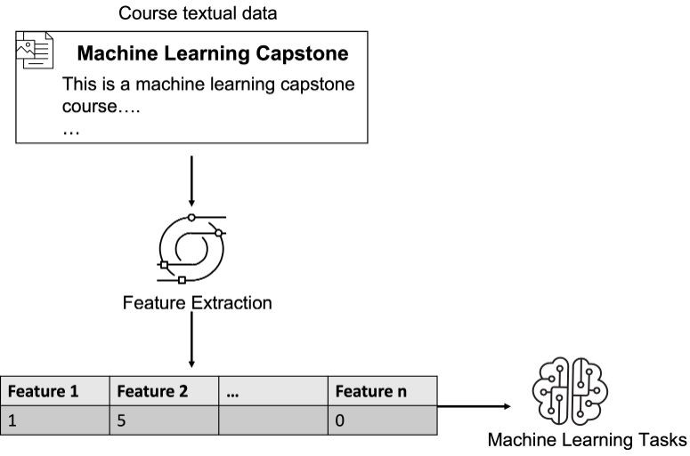
Feature Engineering
The main goal of recommender systems is to help users find items they potentially interested in. Depending on the recommendation tasks, an item can be a movie, a restaurant, or, in our case, an online course.
Machine learning algorithms cannot work on an item directly so we first need to extract features and represent the items mathematically, i.e., with a feature vector.
Many items are often described by text so they are associated with textual data, such as the titles and descriptions of a movie or course. Since machine learning algorithms can not process textual data directly, we need to transform the raw text into numeric feature vectors.

Slide 15
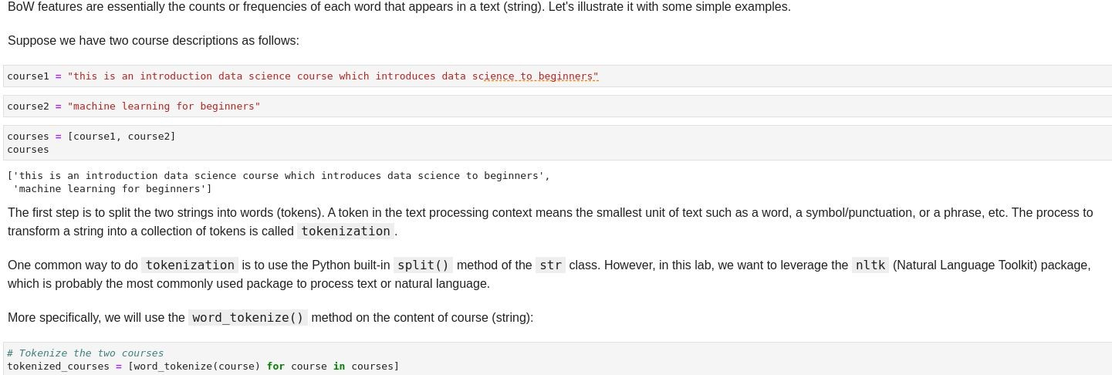
Feature Engineering - BoW
Bag of Words (BoW) features

Slide 16
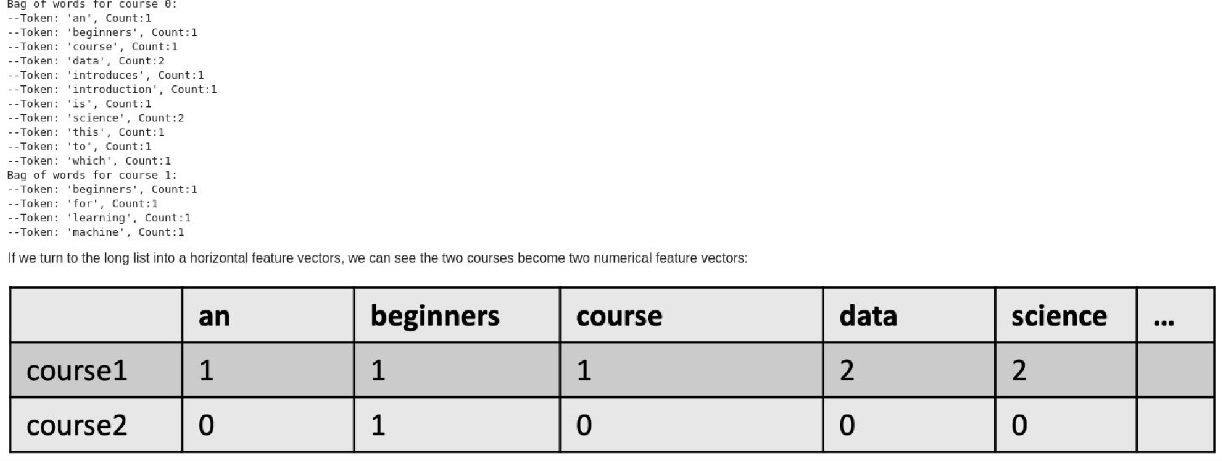
Feature Engineering - BoW
Bag of Words (BoW) features

Slide 17
Feature Engineering - BoW
BoW dimensionality reduction
A document may contain tens of thousands of words which makes the dimension of the BoW feature vector huge.
To reduce the dimensionality, one common way is to ﬁlter the relatively meaningless tokens such as stop words or sometimes add position and adjective words.

Slide 18
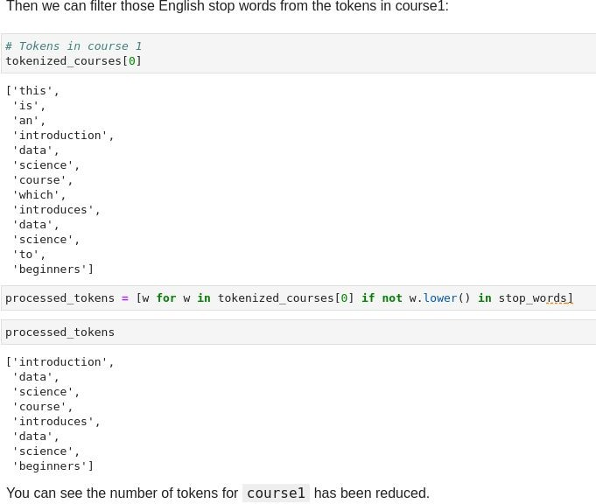
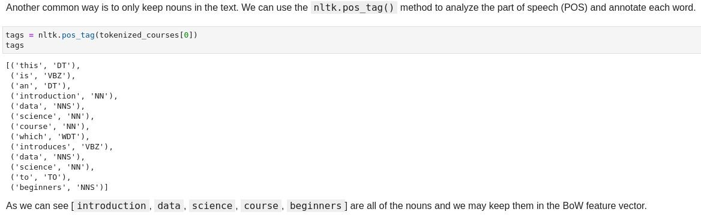
Feature Engineering - BoW
BoW dimensionality reduction

Slide 19
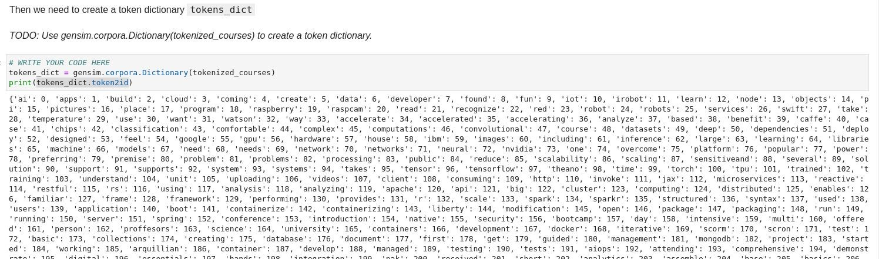
Feature Engineering - BoW
Extract BoW features for course textual content and build a dataset

Slide 20
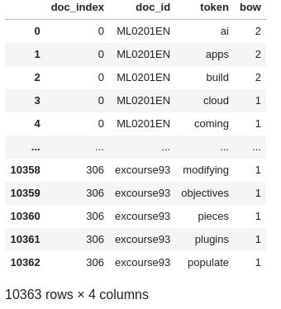
Feature Engineering - BoW
Extract BoW features for course textual content and build a dataset
Create a new course_bow dataframe based on the extracted BoW features. he new dataframe needs to include the following columns (you may include other relevant columns as well):
'doc_index': the course index starting from 0
'doc_id': the actual course id such as ML0201EN
'token': the tokens for each course
'bow': the bow value for each token

Slide 21
Feature Engineering - Course Similarity using BoW Features
Similarity measurement between items is the foundation of many recommendation algorithms, especially for content-based recommendation algorithms. For example, if a new course is similar to user's enrolled courses, we could recommend that new similar course to the user. Or If user A is similar to user B, then we can recommend some of user B's courses to user A (the unseen courses) because user A and user B may have similar interests.
We can use many similarity measurements such as consine, jaccard index, or euclidean distance, and these methods need to work on either two vectors or two sets (sometimes even matrices or tensors).
In previous section, we extracted the BoW features from course textual content. Given the course BoW feature vectors, we can easily apply similarity measurement to calculate the course similarity as shown in the next figure.

Slide 22
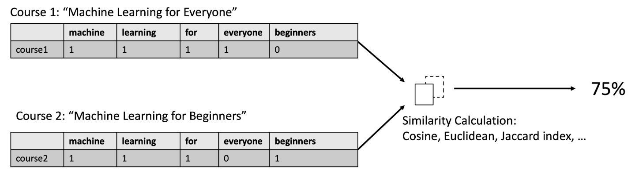
Feature Engineering - Course Similarity using BoW Features

Slide 23
Unsupervised Learning based Recomendation System

Slide 24
Unsupervised Learning based Recomendation System
Outline:
Content-based Course Recommender System using User Proﬁle and Course Genres
Content-based Course Recommender System using Course Similarities
Clustering based Course Recommender System

Slide 25
1. Content-based Course Recommender System using User Proﬁle and Course Genres
The most common type of content-based recommendation system is to recommend items to users based on their proﬁles.
The user's proﬁle revolves around that user's preferences and tastes. It is shaped based on user ratings, including the number of times a user has clicked on different items or liked those items.
The recommendation process is based on the similarity between those items. The similarity or closeness of items is measured based on the similarity in the content of those items.
When we say content, we're talking about things like the item's category, tag, genre, and so on. Essentially the features about an item.

Slide 26
1. Content-based Course Recommender System using User Proﬁle and Course Genres
For online course recommender systems, we already know how to extract features from courses (such as genres or BoW features). Next, based on the course genres and users' ratings, we want to further build user profiles (if unknown).
A user profile can be seen as the user feature vector that mathematically represents a user's learning interests.
With the user profile feature vectors and course genre feature vectors constructed, we can use several computational methods, such as a simple dot product, to compute or predict an interest score for each course and recommend those courses with high interest scores.

Slide 27
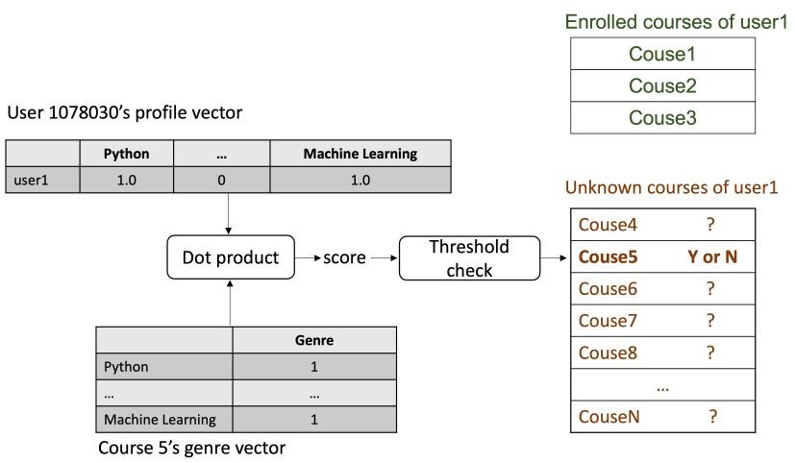
1. Content-based Course Recommender System using User Proﬁle and Course Genres - Pipeline
Get recommend
Raw data Feature engineering
Recomendation
score
Course genres dataframe:
course_id, title, [genre_x, genre_y,...]
User dataframe: user_id, [genre_interest_x, genre_interest_y,...]
Analysis data
Drop the exceptions Normalise data
Use dot product between single user vector and specific course to get recommend score
Make prediction by comparing score with determine threshold

Slide 28
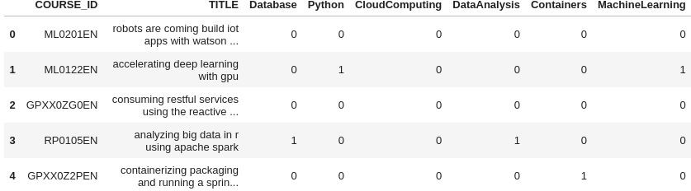
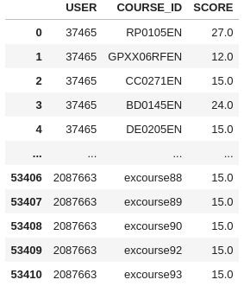


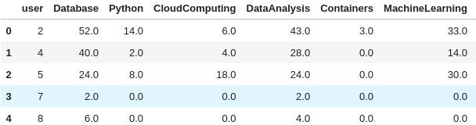
1. Content-based Course Recommender System using User Proﬁle and Course Genres - Result

Slide 29
2. Content-based Course Recommender System using Course Similarities
As we mentioned before, the content-based recommender system is highly based on the similarity calculation among items. The similarity or closeness of items is measured based on the similarity in the content or features of those items. The course genres are important features, and in addition to that, the BoW value is another important type of feature to represent course textual content.
In this lab, we will apply the course similarities metric to recommend new courses which are similar to a user's presently enrolled courses.

Slide 30
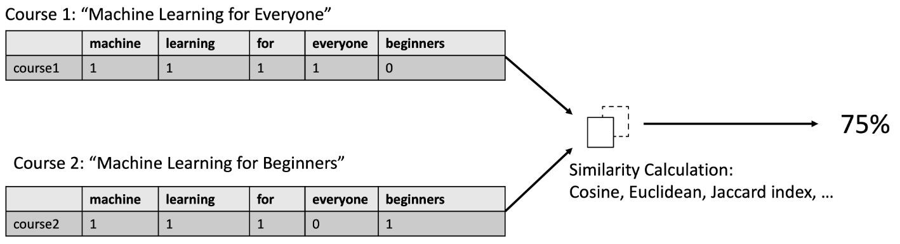
2. Content-based Course Recommender System using Course Similarities - Pipeline
Raw data
Features
Score
Prediction
Course similarity matrix
Course dataframe:
course_id, title, description
Visualise the similarly metric
Handle data text in title and description
Turn a course description to a vector
Check similarity by compare 2 vector
Determine rely on similar score
Remove stop words
word2vec

Slide 31
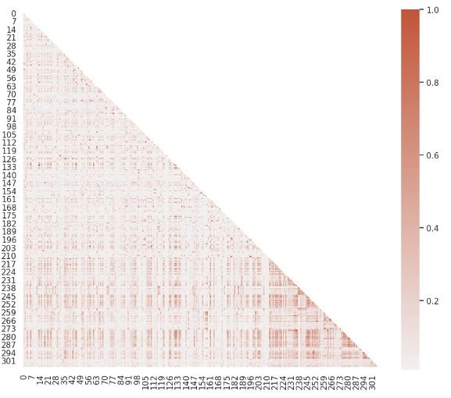
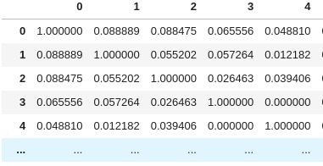
2. Content-based Course Recommender System using Course Similarities
Course similarity matrix:

Slide 32
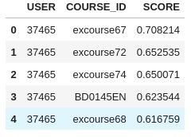
2. Content-based Course Recommender System using Course Similarities - Result
Generate course recommendations based on course similarities for all test users

Slide 33
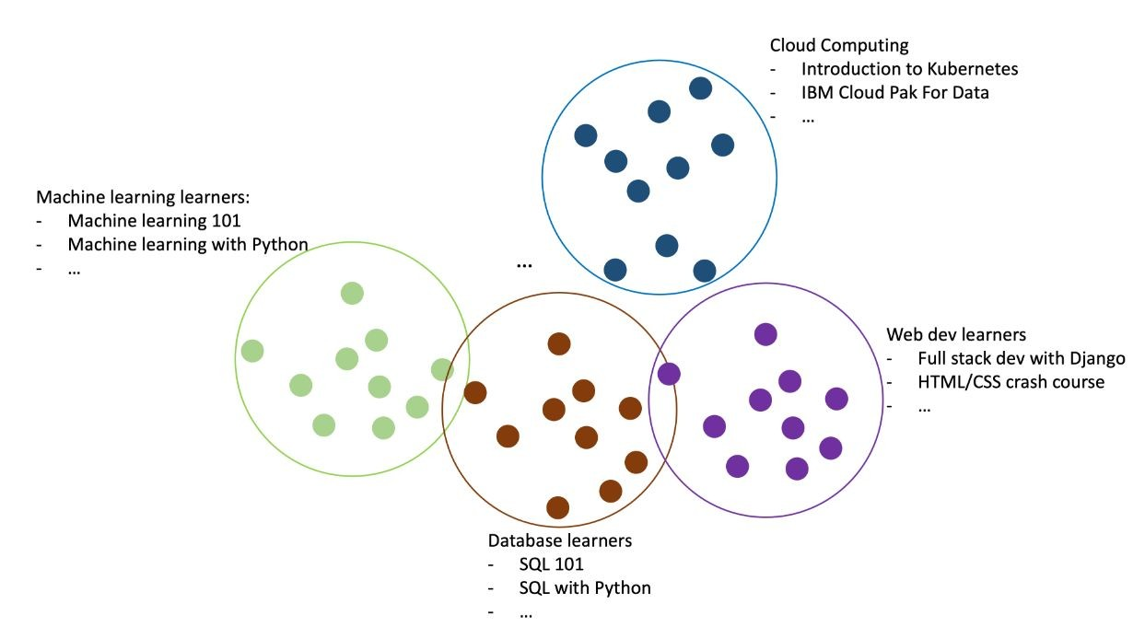
3. Clustering based Course Recommender System
We could perform clustering algorithms such as K-means or DBSCAN to group users with similar learning interests. For example, in the below user clusters, we have user clusters whom have learned courses related to machine learning, cloud computing, databases, and web development, etc.

Slide 34
3. Clustering based Course Recommender System - Pipeline
Raw data
Features
Clusters
Prediction
Raw data:
User profile dataframe: user_id, [genre_x, genre_y,...]
Features:
Normalise user profile features
Apply PCA to keep only important features
Apply Clustering algorithms to group similar courses
Make recommendation by taking courses in user’s interest group

Slide 35
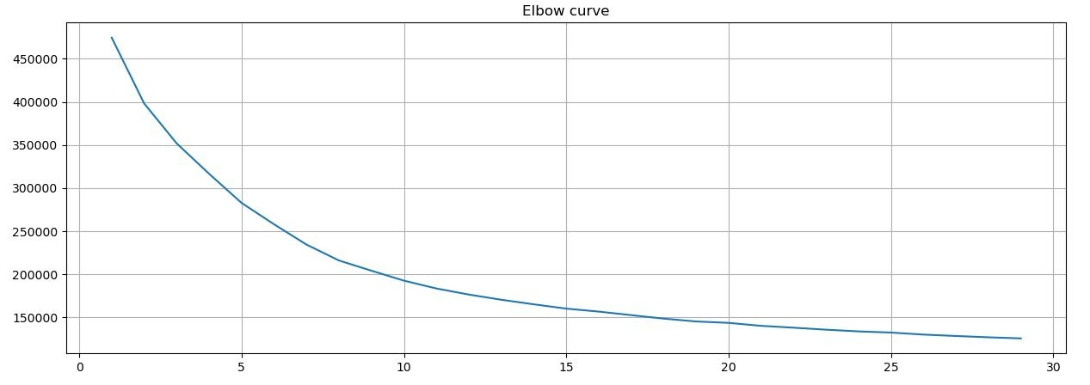
3. Clustering based Course Recommender System
For KMeans algorithm, one important hyperparameter is the number of clusters n_cluster, and a good way to find the optimized n_cluster is using to grid search a list of candidates and find the one with the best or optimized clustering evaluation metrics such as minimal sum of squared distance.
Grid search the optimized n_cluster for KMeans() model

Slide 36
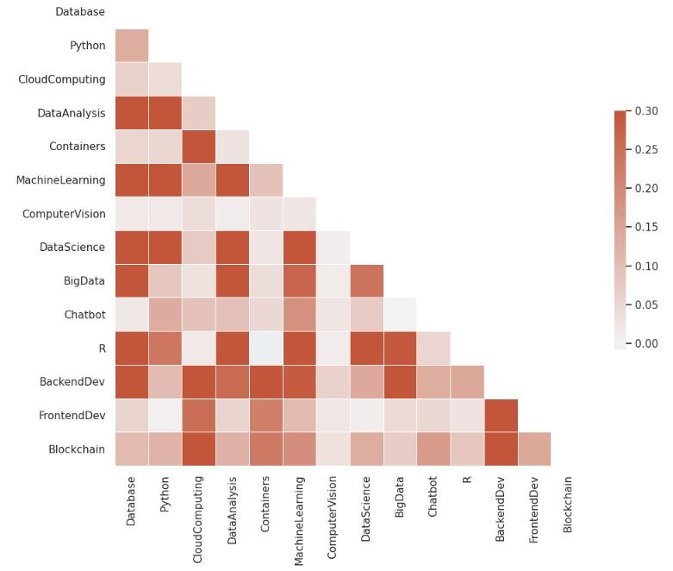
3. Clustering based Course Recommender System
Plot a covariance matrix of the user profile feature vectors with 14 features, we can observe that some features are actually correlated

Slide 37
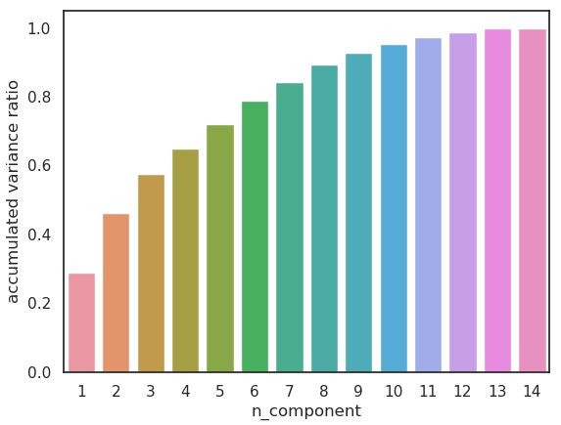
3. Clustering based Course Recommender System
Apply the PCA() provided by scikit-learn to find the main components in user profile feature vectors and see if we can reduce its dimensions by only keeping the main components.
If the accumulated variances ratio of a candidate n_components is larger than a threshold, e.g., 90%, then we can say the transformed n_components could explain about 90% of variances of the original data variance and can be considered as an optimized components size.
We select n_component = 8, due to the minimal ratio > 0.9

Slide 38
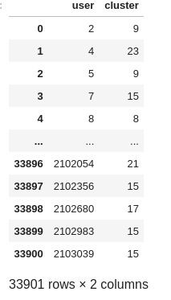
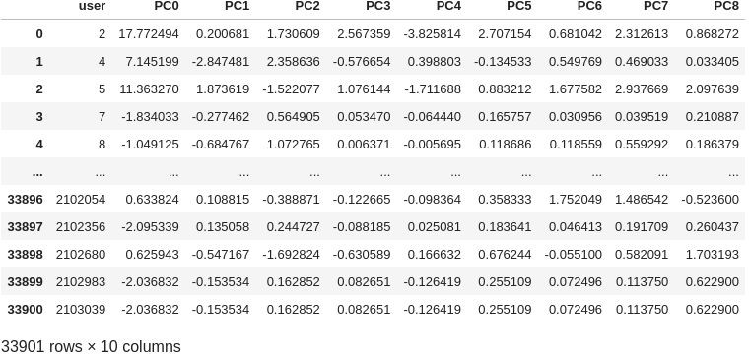
3. Clustering based Course Recommender System
Apply KMean on transformed features:
Apply PCA to features:

Slide 39
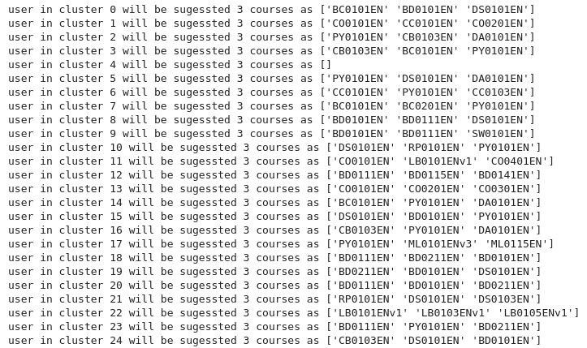
3. Clustering based Course Recommender System
Find popular courses in clusters and suggest to user in cluster:
Insights:
On average, how many new/unseen courses have been recommended per user (in the test user dataset)
What are the most frequently recommended courses? Return the top-10 commonly recommended courses

Slide 40
Supervised Learning based Recomendation System

Slide 41
Supervised Learning based Recomendation System
Outline:
CF using K Nearest Neighbor
CF using Non-negative Matrix Factorization
Course Rating Prediction using Neural Networks
Regression-Based Rating Score Prediction Using Embedding Features
Classiﬁcation-based Rating Mode Prediction using Embedding Features

Slide 42
1. CF using K Nearest Neighbor
Collaborative filtering is probably the most commonly used recommendation algorithm, there are two main types of methods:
User-based collaborative filtering is based on the user similarity or neighborhood
Item-based collaborative filtering is based on similarity among items

Slide 43
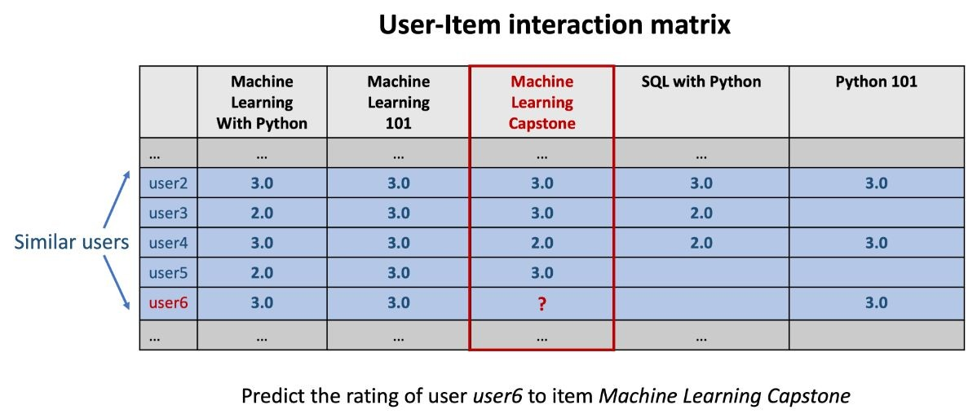
1. CF using K Nearest Neighbor
User-based collaborative filtering looks for users who are similar. This is very similar to the user clustering method done previously; where we employed explicit user profiles to calculate user similarity. However, the user profiles may not be available, so how can we determine if two users are similar?
For most collaborative filtering-based recommender systems, the main dataset format is a 2-D matrix called the user-item interaction matrix. In the matrix, its row is labeled as the user id/index and column labelled to be the item id/index, and the element (i, j) represents the rating of user i to item j.
Below is a simple example of a user-item interaction matrix:

Slide 44
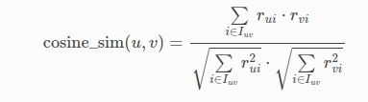
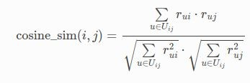
1. CF using K Nearest Neighbor
We used the library library to handle dataset and fit the data.
Surprise
Distance metric: Only common users (or items) are taken into account. The cosine similarity is defined as:
For users u, v:
For items i, j:

Slide 45
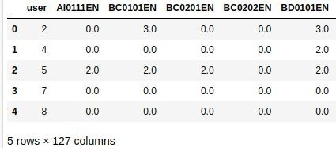
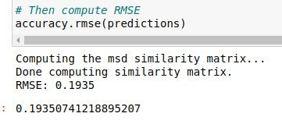
1. CF using K Nearest Neighbor - Pipeline & Result
Raw data
Spare data
Model
Prediction
User - item - rating - dataframe: user_id, item, rating
Use pivot method in pandas to turn data to features
Fit data to KNN model based on surprise library
Use distance metric listed in previous page
Make prediction by test data, use RMSE metric to evaluate model performance

Slide 46
2. CF using Non-negative Matrix Factorization
A dimensionality reduction algorithm called Non-negative matrix factorization (NMF), which decomposes a big sparse matrix into two smaller and dense matrices.
Non-negative matrix factorization can be one solution to big matrix issues. The main idea is to decompose the big and sparse user-interaction into two smaller dense matrices, one represents the transformed user features and another represents the transformed item features

Slide 47
2. CF using Non-negative Matrix Factorization
An example is shown below, suppose we have a user-item interaction matrix 𝐴 with 10000 users and 100 items (10000 x 100), and its element (j, k) represents the rating of item k from user j. Then we could decompose 𝐴 into two smaller and dense matrices 𝑈 (10000 x 16) and 𝐼 (16 x 100). for user matrix 𝑈 , each row vector is a transformed latent feature vector of a user, and for the item matrix 𝐼 , each column is a transformed latent feature vector of an item.
Here the dimension 16 is a hyperparameter defines the size of the hidden user and item features, which means now the shape of transposed user feature vector and item feature vector is now 16 x 1.
The magic here is when we multiply the row j of 𝑈 and column k of matrix 𝐼 , we can get an estimation to the original rating 𝑟̂ _𝑗𝑘 .
For example, if we preform the dot product user ones row vector in 𝑈 and item ones column vector in 𝐼 , we can get the rating estimation of user one to item one, which is the element (1, 1) in the original interaction matrix 𝐼 .

Slide 48
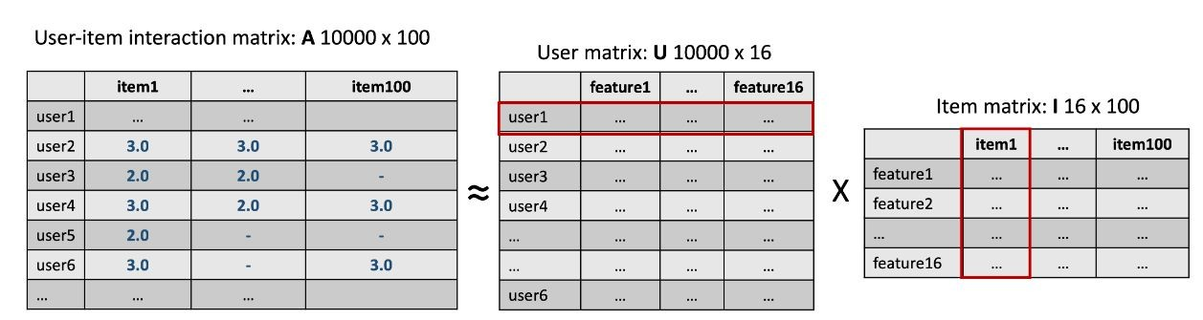
2. CF using Non-negative Matrix Factorization

Slide 49
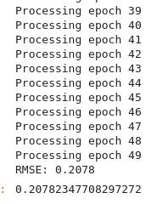
2. CF using Non-negative Matrix Factorization - Pipeline & Result
Decomposed
Raw data Model Prediction
matrix
User - item - rating - dataframe: user_id, item, rating
Use surprise library to decompose full matrix to two smaller and denser ones: user matrix and item matrix
Dot product each row in user matrix with each column in item matrix
Make prediction by test data, use RMSE metric to evaluate model performance

Slide 50
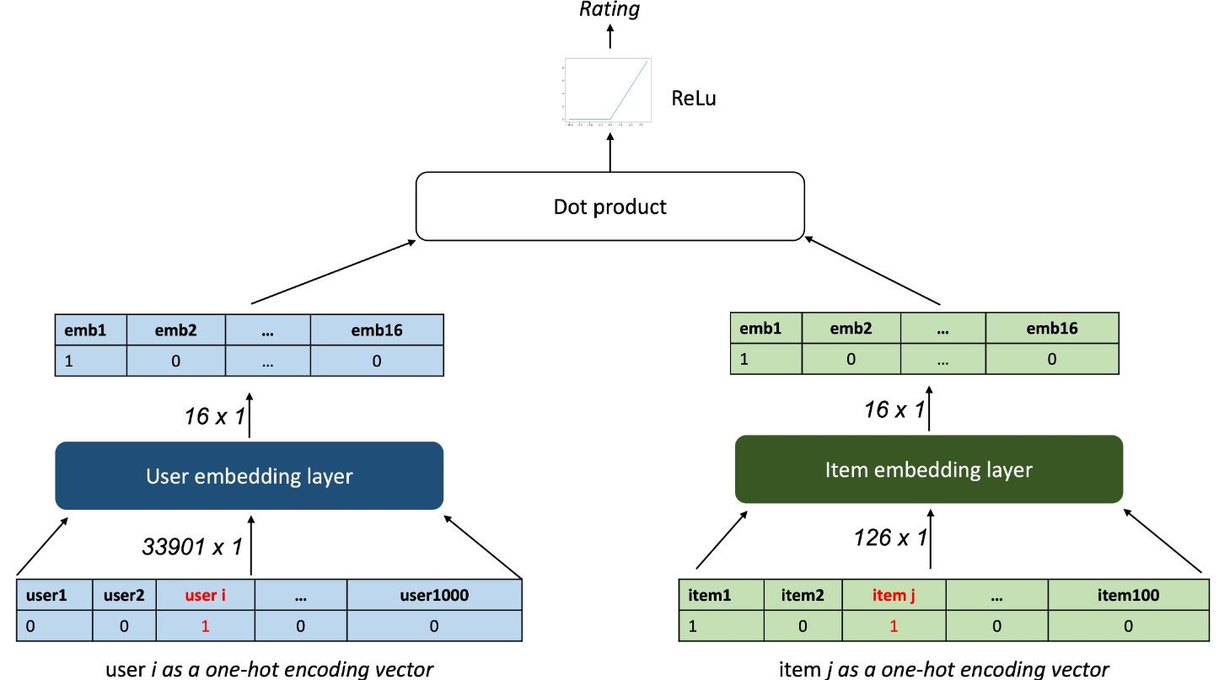
3. Course Rating Prediction using Neural Networks
The goal is to create a neural network structure that can take the user and item one-hot vectors as inputs and outputs a rating estimation or the probability of interaction (such as the probability of completing a course).
While training and updating the weights in the neural network, its hidden layers should be able to capture the pattern or features for each user and item. Based on this idea, we can design a simple neural network architecture like the following:

Slide 51
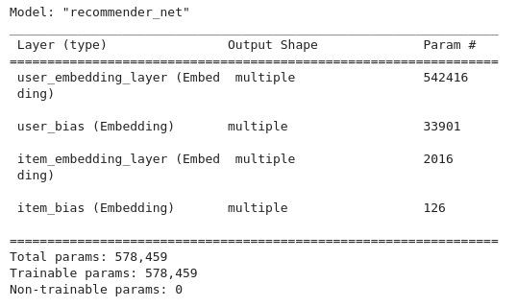
3. Course Rating Prediction using Neural Networks
Model:
Optimizer: Adam
Loss: Mean Square Error
Metric: Mean Square Error
Epoch 12
Batch size: 512

Slide 52
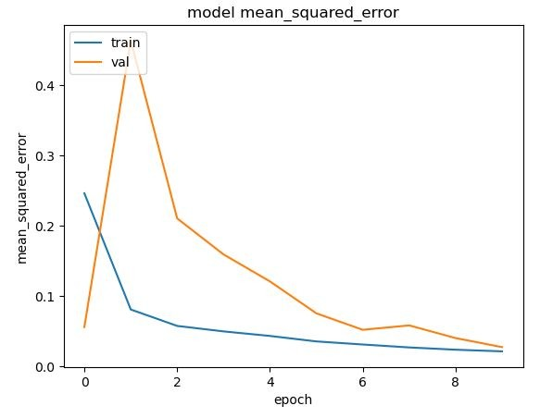
3. Course Rating Prediction using Neural Networks -
Result
Train and Validate:
Result on test data:
Mean squared error: 0.258
Root mean squared error: 0.508

Slide 53
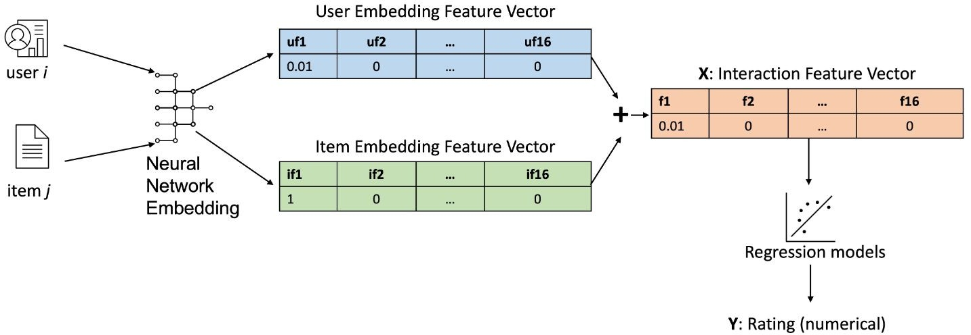
4. Regression-Based Rating Score Prediction Using Embedding Features
Another way to make rating predictions is to use the embedding as an input to a neural network by aggregating them into a single feature vector as input data X.
With the interaction label Y such as a rating score or an enrollment mode, we can build our other standalone predictive models to approximate the mapping from X to Y, as shown in the above flowchart.

Slide 54
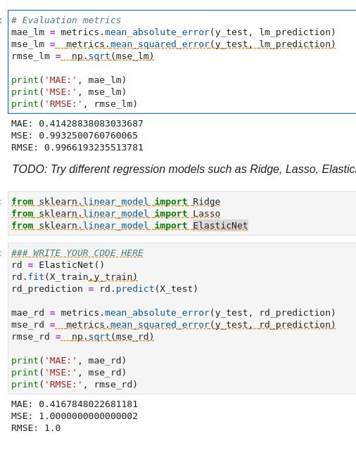
4. Regression-Based Rating Score Prediction Using Embedding Features - Result

Slide 55
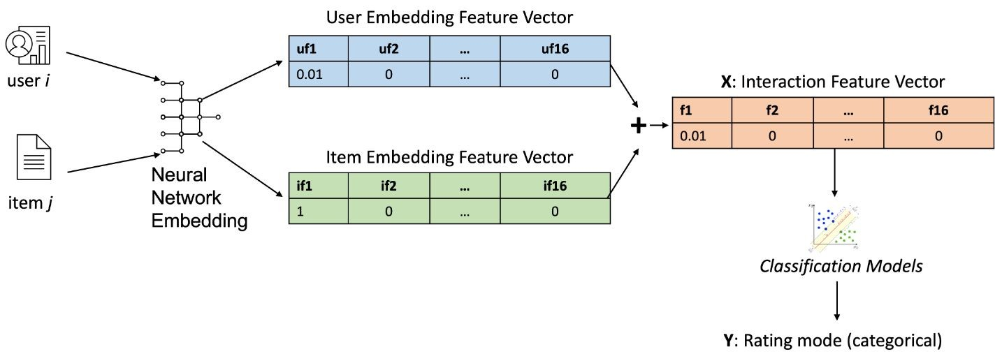
Classiﬁcation-based Rating Mode Prediction using Embedding Features
We first extract two embedding matrices out of the neural network, and aggregate them to be a single interaction feature vector as input data X.
This time, with the interaction label Y as categorical rating mode, we can build classification models to approximate the mapping from X to Y, as shown in the above flowchart.

Slide 56
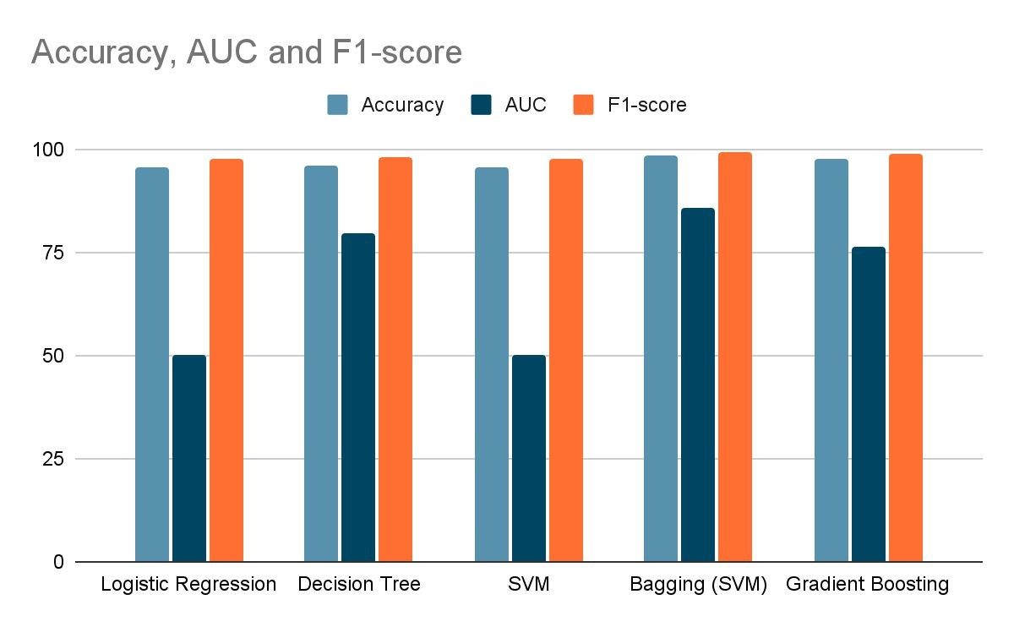
5. Classiﬁcation-based Rating Mode Prediction using Embedding Features
 | Accuracy | AUC | F1-score
Logistic Regressi on | 95.45 | 0.5 | 97.67
Decision Tree | 96.12 | 79.51 | 97.97
SVM | 95.45 | 0.5 | 97.67
Bagging (SVM) | 98.37 | 85.62 | 99.15
Gradient Boosting | 97.5 | 76.44 | 98.7

Slide 57
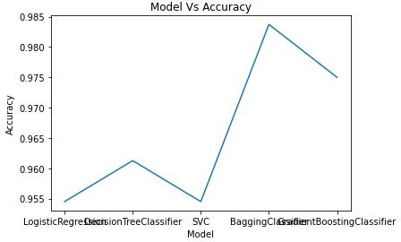
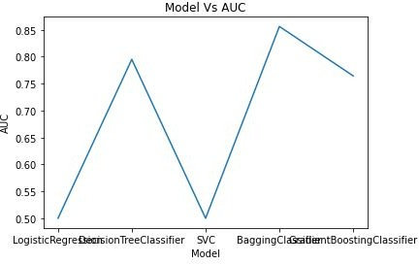
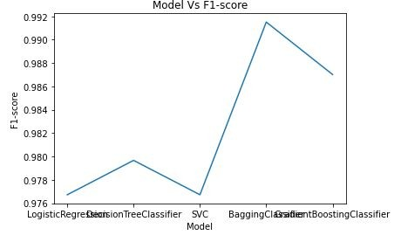
5. Classiﬁcation-based Rating Mode Prediction using Embedding Features

Slide 58
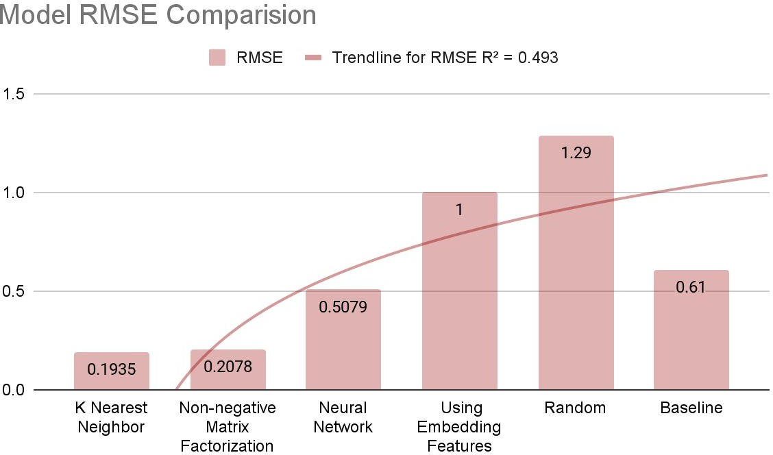
Compare the performance of collaborative-ﬁltering models
Insights:
Random prediction is obviously worst
KNN method have

Slide 59
Deploy and showcase models on Streamlit

Slide 60
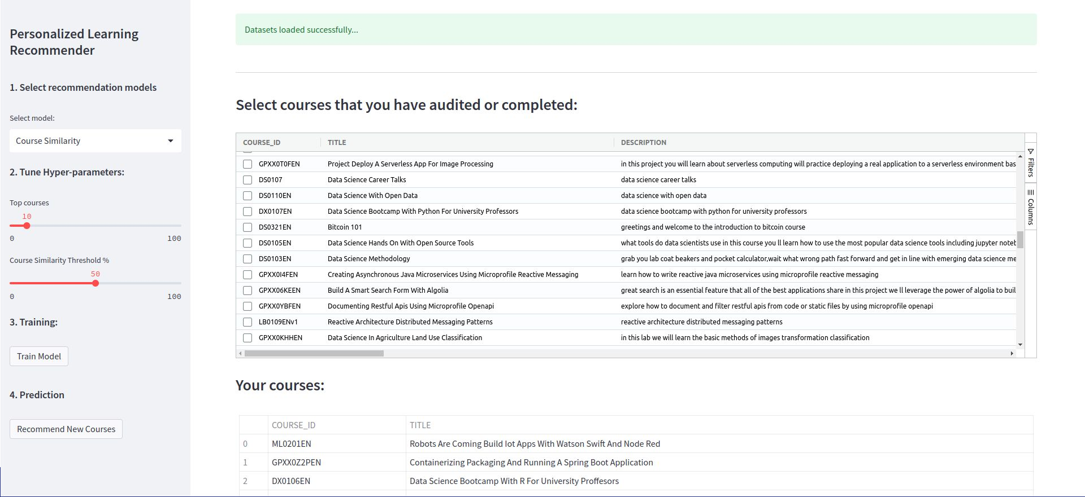
Deploy and showcase models on Streamlit

Slide 61

Deploy and showcase models on Streamlit

Slide 62
Future work
This project shows how a end-to-end machine learning pipeline work. Although we pass all requirement of course’s creator, there are several enhancements can be applied for better accuracy and complete the perfection:
Experience with real customer data
Apply more pre-processing techniques
Deal with spare data which can cause full of memory

Slide 63
Thanks for your reading!

